Slide 1


Tutorial 2 - Classification
Data: Human Activity Recognition Using Smartphone Sensors (2012)
Source: https://archive.ics.uci.edu/ml/datasets/human+activity+recognition+using+smartphones

Slide 2

Supervised Learning – You Already Have Target Data
Regression:
How much will a customers spend?
Classification:
Will a customer make a purchase? Yes or No
yes
no
y
x_{j}
X
x_{i}
H₂O algos:
Penalized Linear Models
Random Forest
Gradient Boosting
Neural Networks
Stacked Ensembles
H₂O algos:
Penalized Linear Models
Naïve Bayes
Random Forest
Gradient Boosting
Neural Networks
Stacked Ensembles

Slide 3
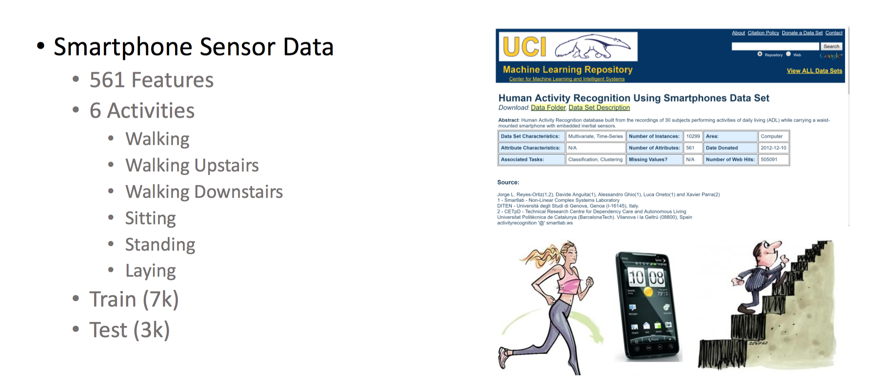

Slide 4
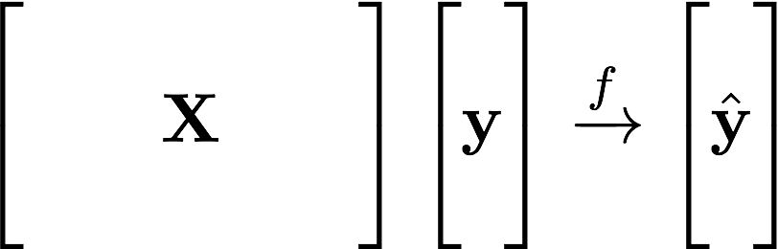
Supervised Learning Example
Machine Learning:
Learn Patterns
from Data
Historical Data:
Smartphone Sensors
Target:
Six Different
Human Activities
Predicted Activity

Slide 5
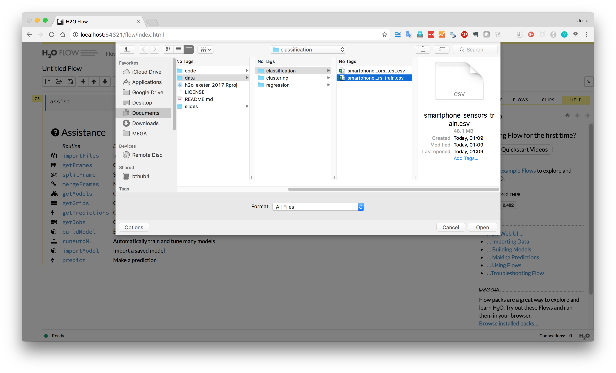
Select data for classification tutorial

Slide 6
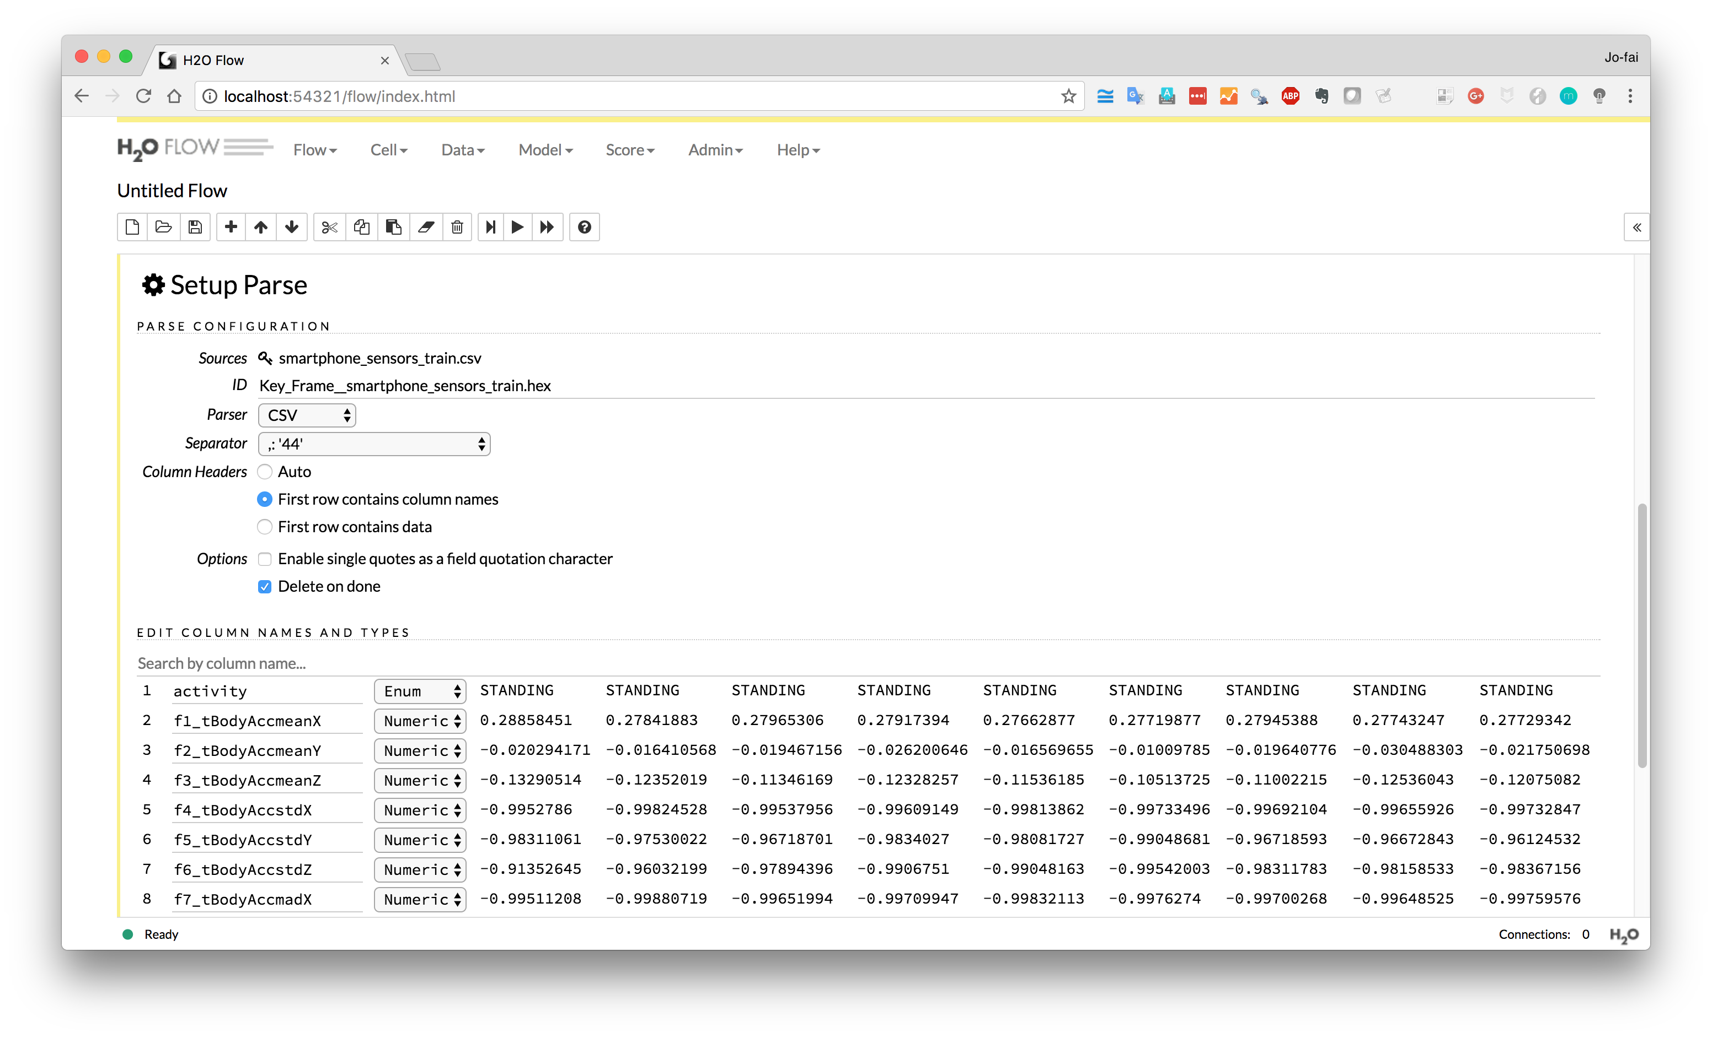
Enum = Categorical Value (in Java)

Slide 7
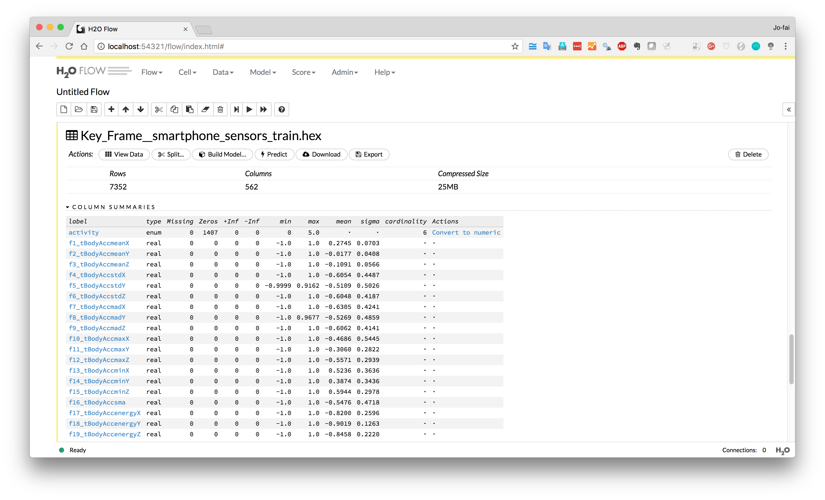
Exploratory analysis
(click on any variable)

Slide 8
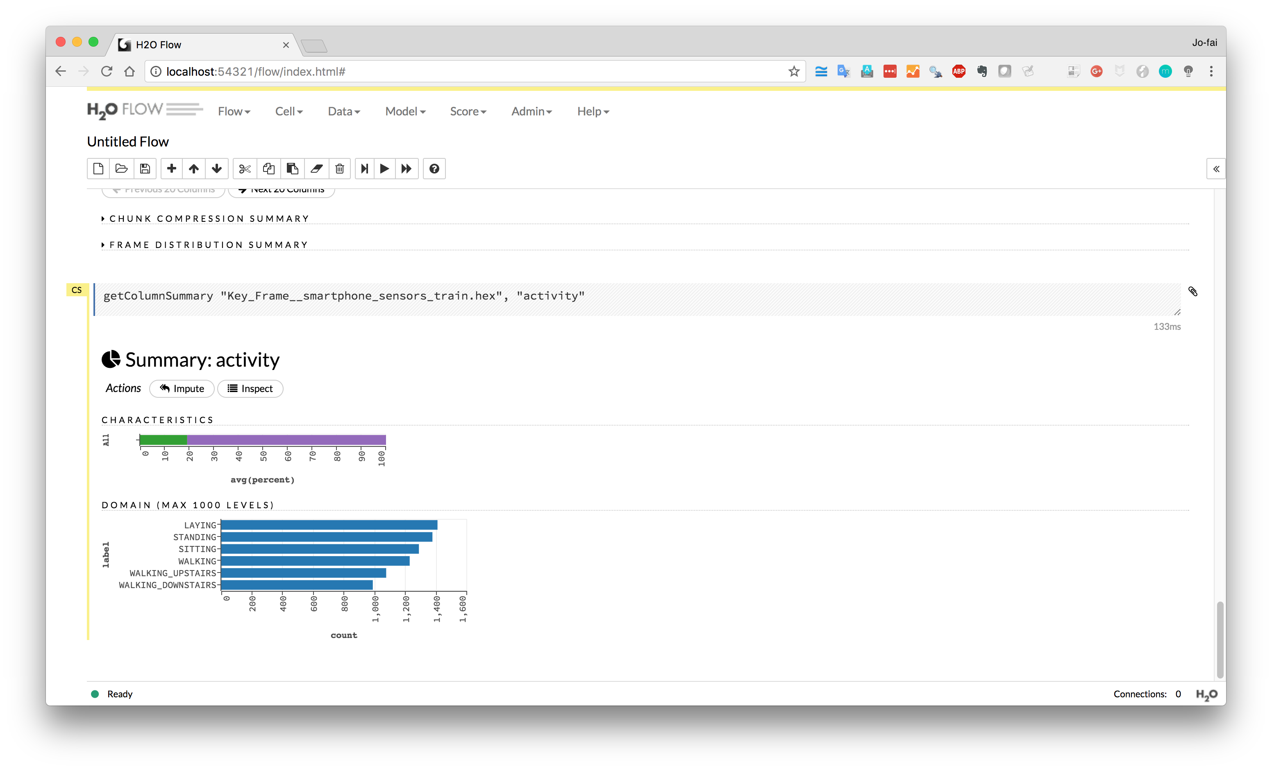

Slide 9
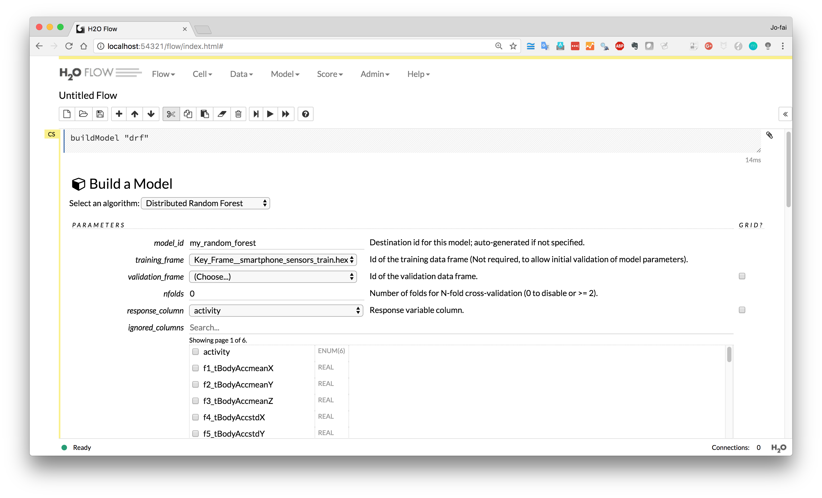
Build Random Forest Model
Select “…_train” dataset
Select “activity” as response

Slide 10
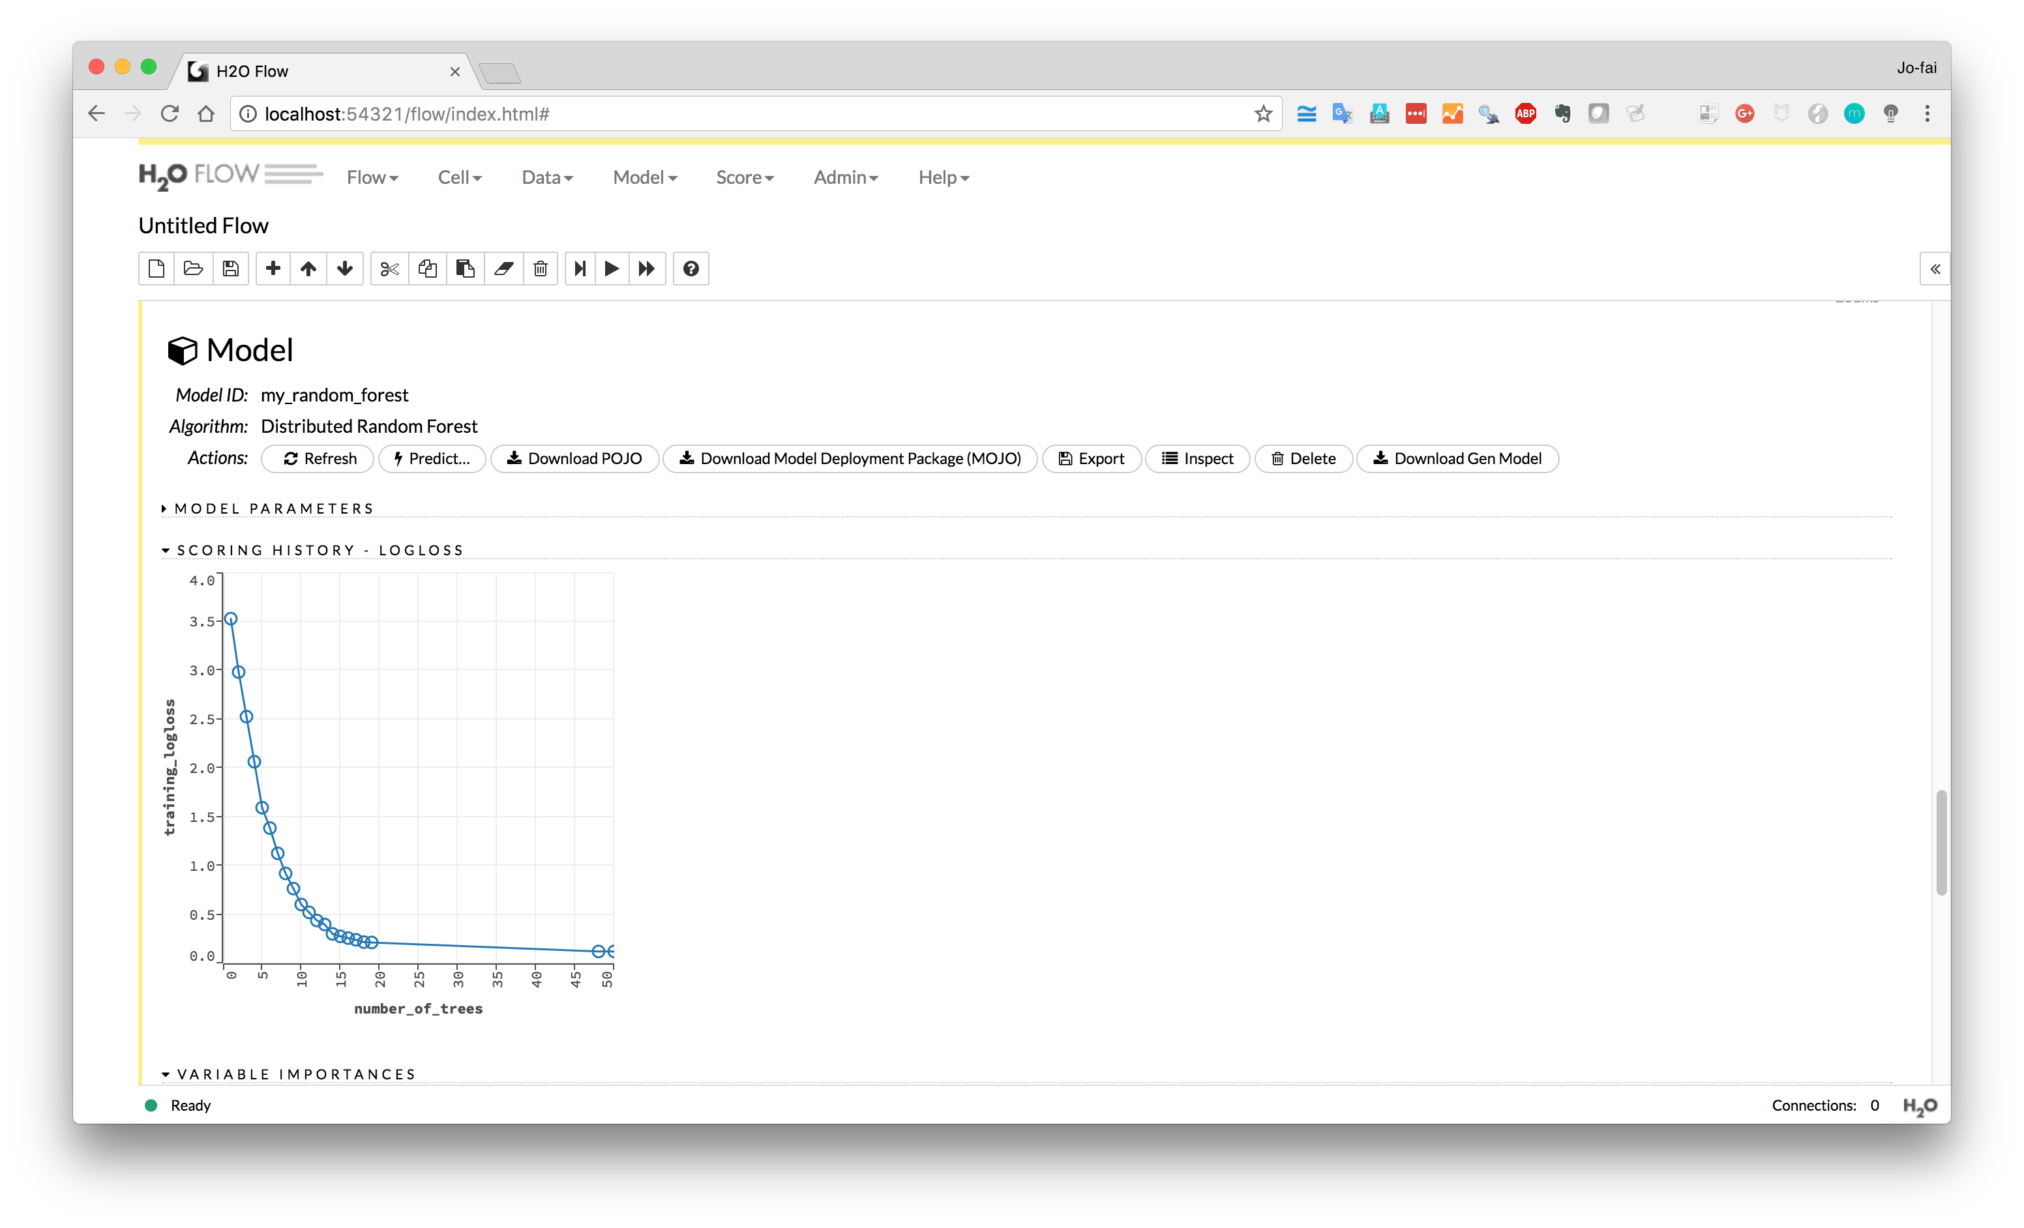
Performance metric
Logarithmic Loss (logloss)
A loss function for classification

Slide 11
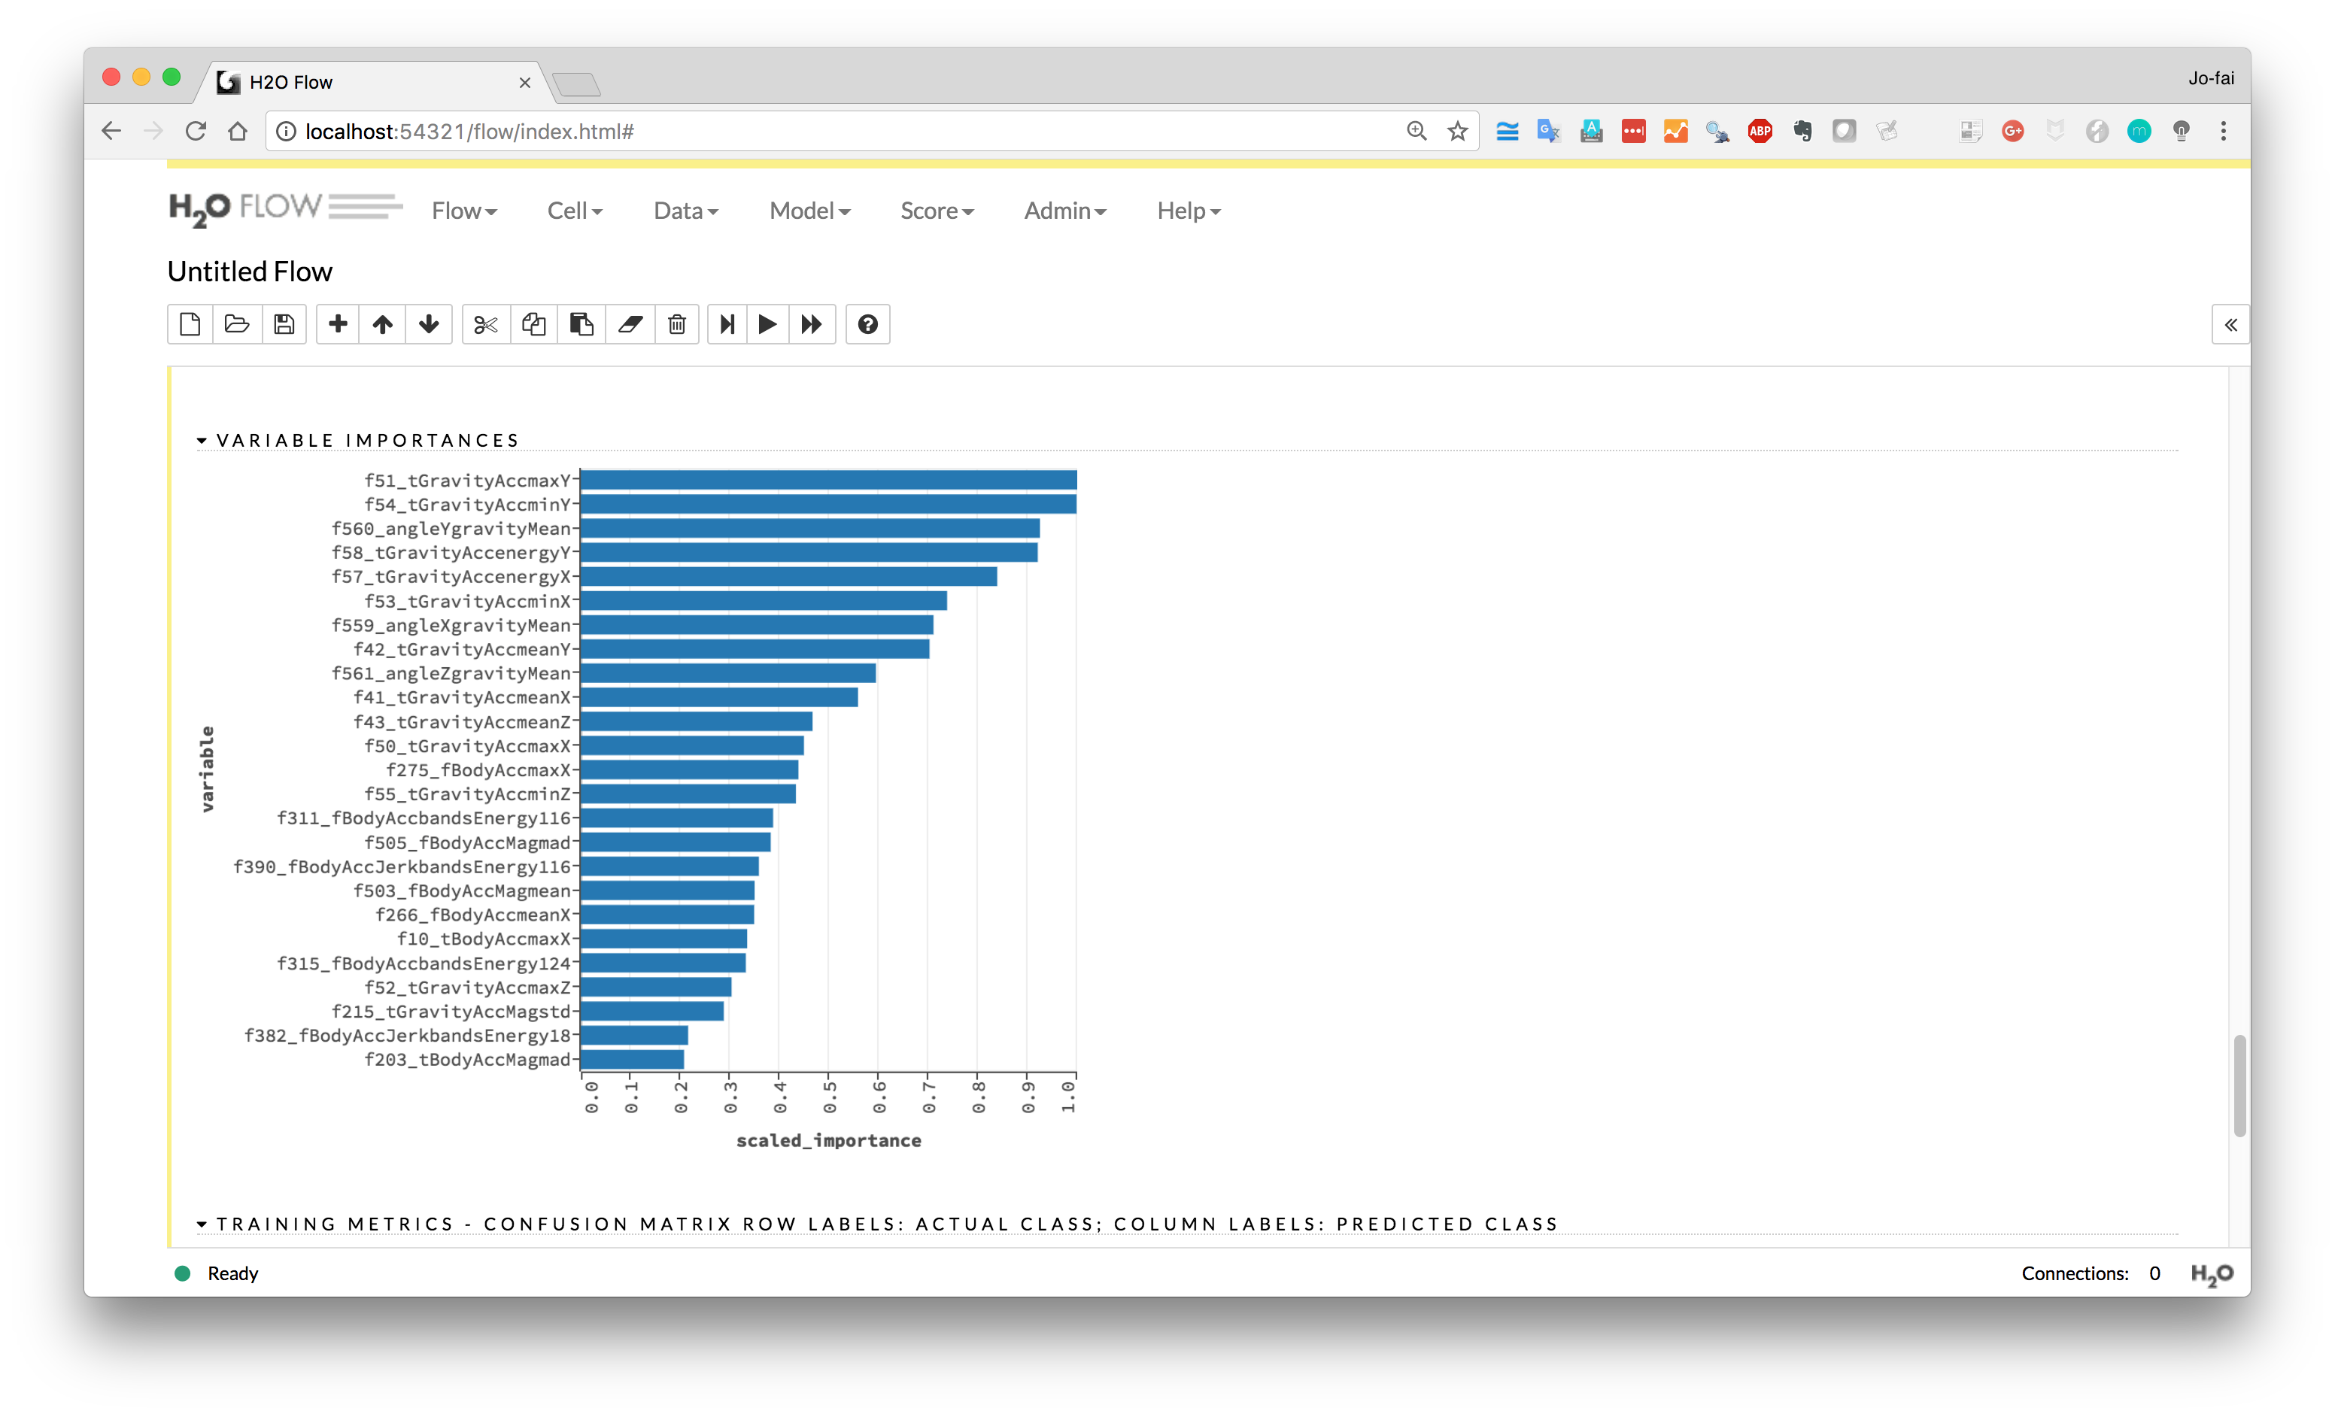
Check out variable importance

Slide 12
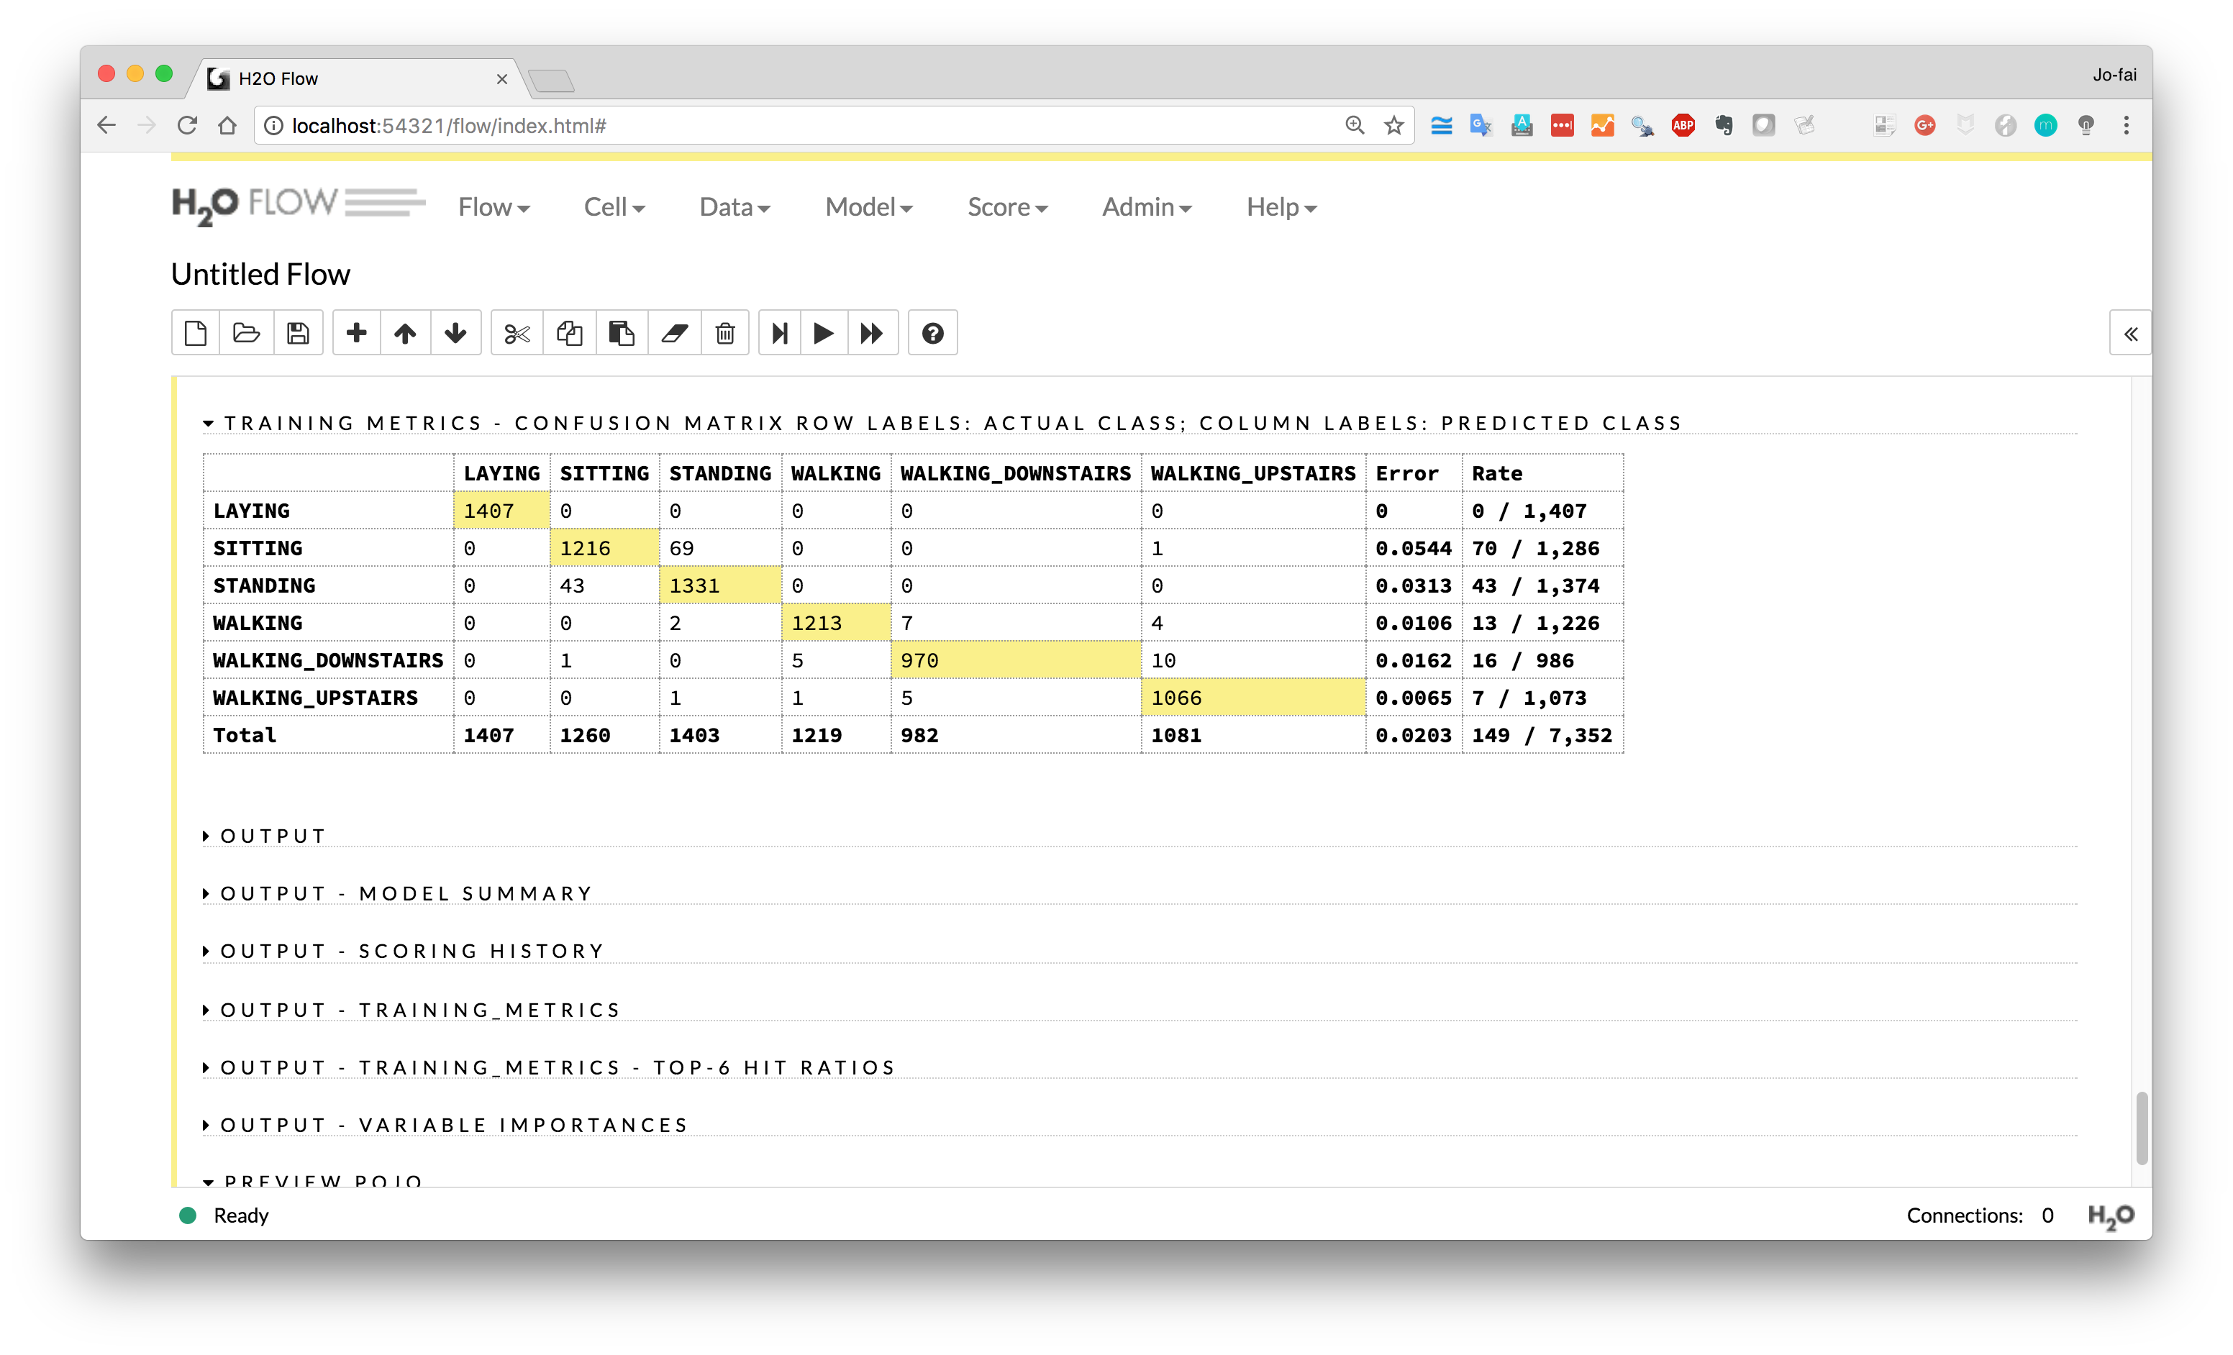
Confusion Matrix
(Yellow cells = correct predictions)

Slide 13
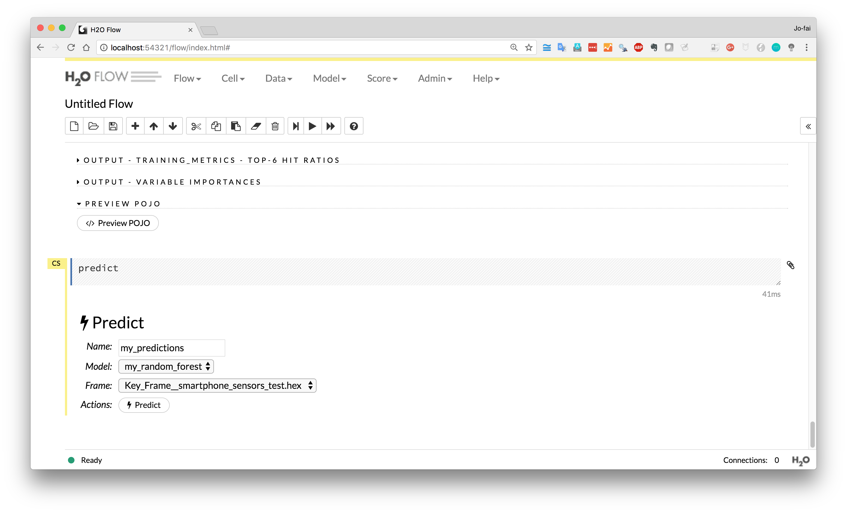
Make predictions on test set

Slide 14
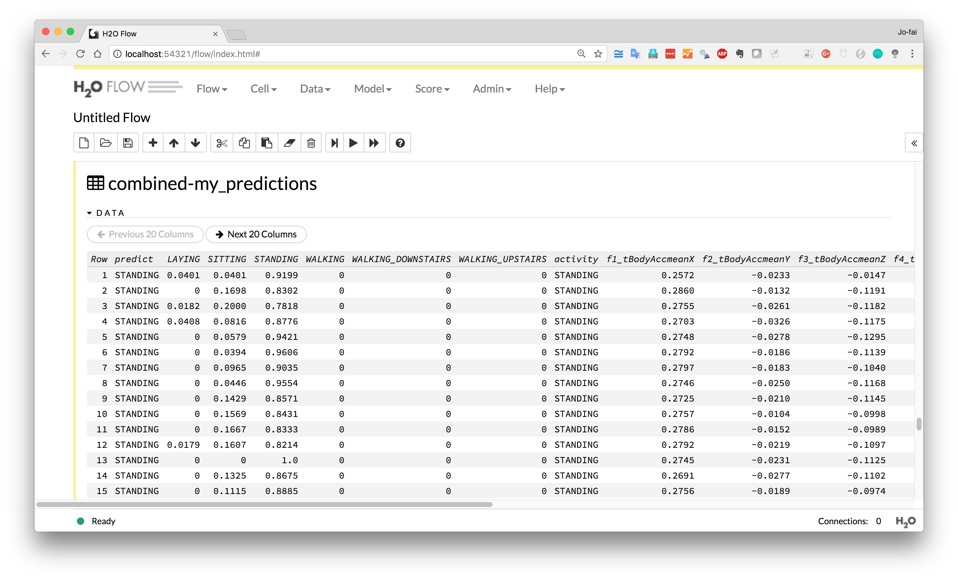
Compare Results
Predictions (with prob. of each class)
Ground Truth

Slide 15
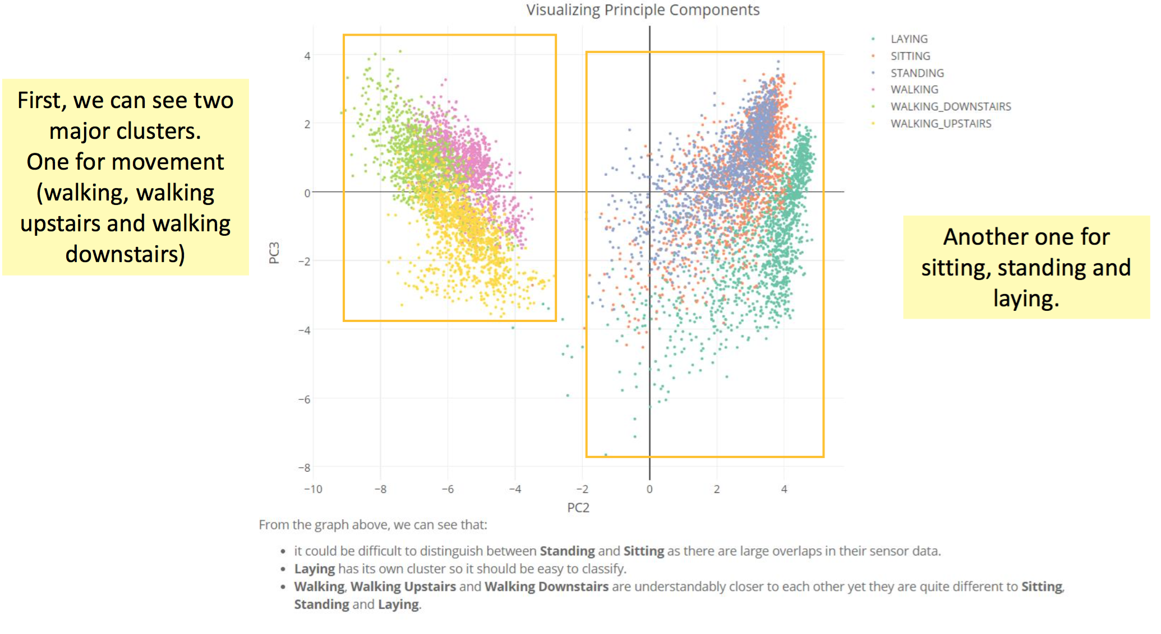
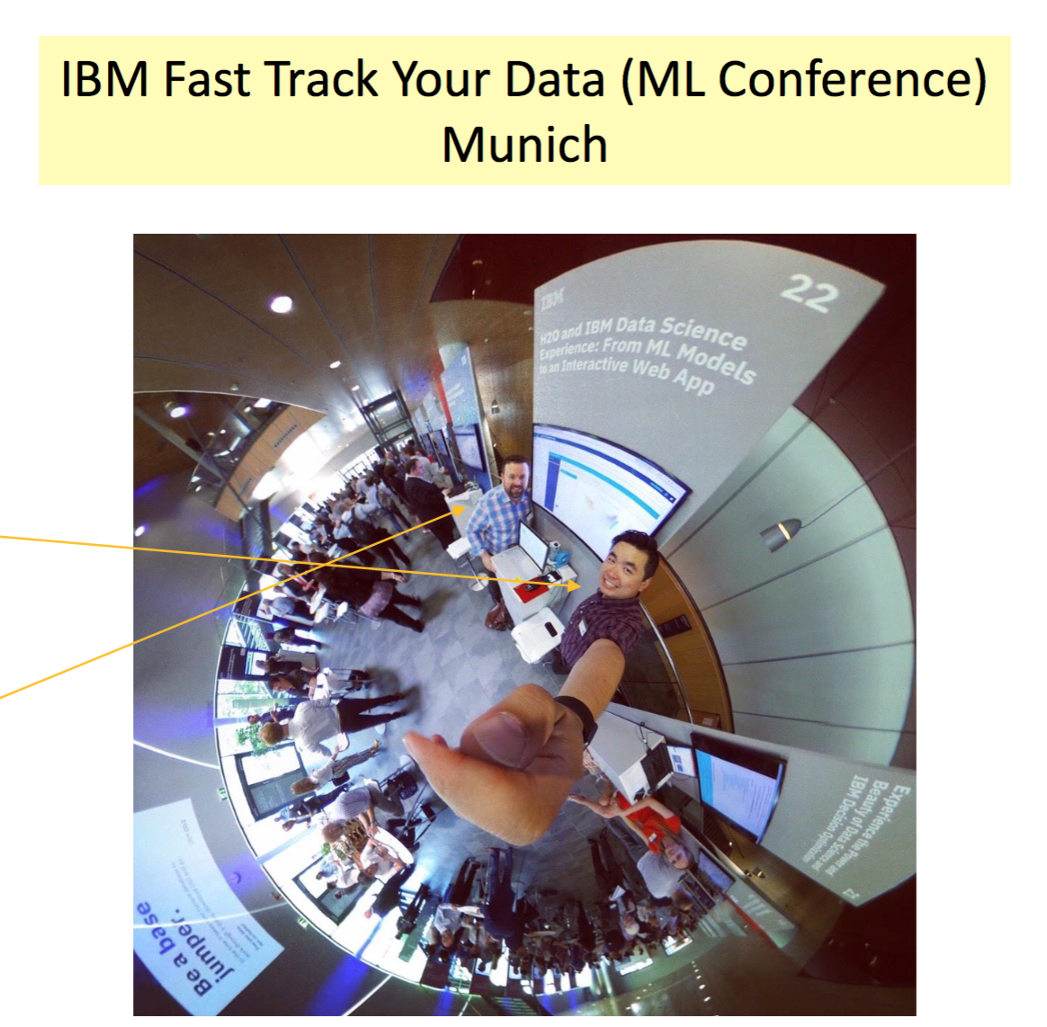
H₂O Demo at IBM Conference
https://github.com/woobe/h2o_demo_for_ibm_dsx

